Slide 1
Names, Bindings, and Scopes Principles of Programming Language
S.Venkatesan
Reference: Robert W. Sebesta, Concepts of Programming Languages, 10th Edition, Pearson

Slide 2
Introduction
A programming language variable can be characterized by a collection of properties, the most important is type.
The data type designing have different issues however, the scope and lifetime of the variables are important.
Functional programming languages allow expression to be named but in imperative languages expressions are assigned to variables (they are like named constants for imperative).

Slide 3
Names -- Identifiers
Design Issues
Are names case sensitive?
Are the special words of the language reserved words or keywords?

Slide 4
Name Forms
It is a string of characters used to identify some entity in a program.
Fortran 95+ - upto 31 characters
C99 – no limitation for internal names but only first 63 are significant. 31 characters for external.
Representation – underscore, dollar, etc.
C-based languages – Rose, ROSE, rose <- affects readability.
Java – ParseInt -> affects writability

Slide 5
Special Words
Keyword
Reserved word
COBOL – has 300 reserved words.
Explicit import will use the pre-define words otherwise it will not impact.

Slide 6
Variables
It is more than names for memory location.
Numeric memory addresses for data with names. <- better readability as well as write and maintain.
Six tuple characterization (name, address, value, type, lifetime and scope).

Slide 7
Address
It is the machine memory address.
At different times associated with different addresses.
l-value – address of a variable.
Aliases –
Multiple variables that have the same address.
It has hindrance that if one changes others also affects.
In C and C++ is with the union type.
Pointers
Reference variable

Slide 8
Type
int
char

Slide 9
Value
The value of a variable is the contents of the memory cell or cells associated with the variable.
Abstract Cell Vs Physical Cell (each cell) -> memory cell means abstract memory cell.
It is sometime called as r-value – to access r-value, the l-value must be determined.

Slide 10
Binding
It is an association between an attribute and an entity, such as between a variable and its type or value (or) between an operation and a symbol.
The time at which a binding takes place is binding time.
Binding at language implementation time (for example, * at language design time), compile time, load time, link time or run time.
Static vs Dynamic binding

Slide 11
Static Type Binding
Explicit declaration – is a statement in a program that lists variables names and specifies that they are a particular type.
Implicit declaration – through default conventions rather than declaration statements. (for example in fortran if variable starts with any of I, J, K, L, M or N or their lowercase it is implicitly declared to be Integer type)

Slide 12
Dynamic Type Binding
Based on the valued it is assigned in the assignment statement.
List = [10.2, 13.5]
List = 47
The option of dynamic type binding was introduced in C#2010.
A variable can be declared to use dynamic type binding by including the dynamic reserved word in it declaration.
dynamic any

Slide 13
Storage Bindings and Lifetime
The process allocation is allotment of memory cell.
Deallocation is making the memory cell to available memory.
Lifetime of a variable is the time during which the variable is bound to a specific memory location.

Slide 14
Static Variables
Are those that are bound to memory cells before program execution begins and remain until program execution terminates.
No overhead at runtime.
Reduced flexibility.
Static specifier in c , c++ or Java (it is class variable rather than an instance variable)

Slide 15
Stack-Dynamic Variables
Those whose storage bindings are created when their declaration statements are elaborated, but whose types are statically bound.
For example, the variable declarations that appear at the beginning of a Java method are elaborated when the method is called and the variables defined by those declarations are deallocated when the method completes its execution.
If variables declared in functions.

Slide 16
Explicit Heap-Dynamic Variables
Are nameless memory cells that are allocated and deallocated by explicit run-time instructions written by the programmer.
These variables, which are allocated from and deallocated to the heap, can only be references through pointer or reference variable.
It is disorganized because of the unpredictability of its use.
Bound to type at compile time and storage at run time.

Slide 17
Implicit Heap-Dynamic Variables
Only when they are assigned values.
It has runtime overhead of maintaining all the dynamic attributes, which could include array subscript types and ranges, among others.

Slide 18
Scope
It is the range of statements in which the variable is visible.
Local
Global
Static Scope – before execution
the compiler first searches in the current block, then in global variables

Slide 19
Blocks
Have its own local variables whose scope is minimized.
Is it stack dynamic?

Slide 20
Declaration Order
Must appear at the beginning of the function (C89).
However, c99, c++, Java, JavaScript and C# allow variable declarations to appear anywhere a statement can appear in a program unit.

Slide 21
Global Scope
Variable declarations can appear outside the functions.
Need to give “extern” in C99 for visibility of variable, if variable is declared after function

Slide 22
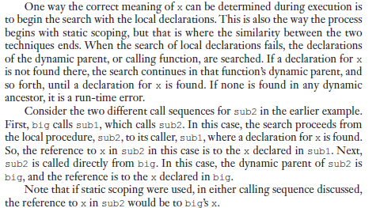
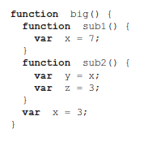
Dynamic Scoping
It is based on the calling sequence of subprograms, not on their spatial relationship to each other. Thus, the scope can be determined at run time.

Slide 23
Scope and Lifetime
Although scope and lifetime of the variable are clearly not the same,
because static scope is textual, or spatial, concept
whereas lifetime is a temporal concept,
they at least appear to be related in this case.
In C and C++, it does not hold for example, the static definer is statically bound to the scope of that function and is also statically bound to the storage. So, its scope is static and local to the function but its lifetime extends over the entire execution of the program of which it is a part.

Slide 24
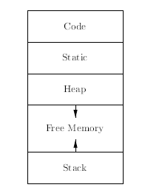
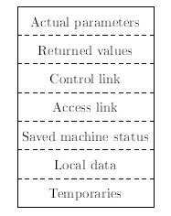
Runtime Memory

Slide 25
Referencing Environments
It is a collection of all variables that are visible in the statement.
The referencing environment of a statement in a static-scoped language is the variables declared in its local scope plus the collection of all variables of its ancestor scopes that are visible.

Slide 26
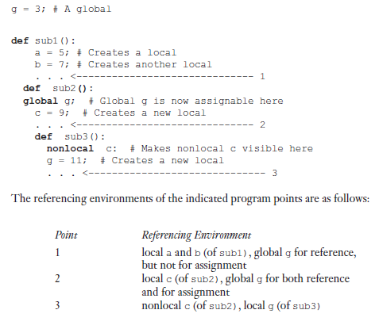
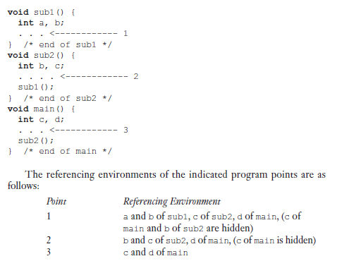
Python Example

Slide 27
Named Constants
It is a variable that is bound to a value only once.
It increases the readability and program reliability for example pi.
Another use of is parameterize.
Ada and C++ allow dynamic binding of values to named constants.
C++ , const int result = 2 * width + 1
Java, final
C#, const and readonly
Static (before run time - initialization) and dynamic at run time.

